Slide 1

BlinkIT Sales Business Analysis
This Sales Business Comprehensive Analysis Using Power BI will help the decision makers of BlinkIT to serve their customer much efficiently.
By Rounak Pyne

Slide 2
Table of Contents:
Introduction
Business Requirements
KPIs and Metrics
Data Walkthrough
Visualizations
Insights and Recommendations
Conclusion

Slide 3
Introduction:
Overview: This project focuses on analyzing Blinkit's sales performance, customer satisfaction, and inventory distribution. This project is dedicated to a comprehensive analysis of Blinkit's operations, with a primary focus on three critical aspects:
Sales Performance: This involves examining the sales data to identify trends, patterns, and insights that can help in understanding the overall performance. Key metrics such as revenue growth, sales volume, and profit margins will be analyzed. The objective is to pinpoint high-performing products, recognize seasonal sales variations, and identify potential areas for improvement.
Customer Satisfaction: The analysis will delve into customer feedback and satisfaction metrics to gauge the overall customer experience. This includes analyzing survey results, customer reviews, and feedback scores to understand the level of satisfaction among Blinkit's customers. By identifying common pain points and areas of excellence, we aim to recommend strategies for enhancing customer satisfaction and loyalty.
Inventory Distribution: This component focuses on the efficiency and effectiveness of Blinkit's inventory management. The goal is to analyze inventory data to understand stock levels, turnover rates, and distribution efficiency across various locations. By examining supply chain logistics, we aim to identify potential bottlenecks and suggest improvements to ensure optimal inventory levels, reduce wastage, and enhance distribution efficiency.
Together, these analyses will provide a holistic view of Blinkit's operational performance, highlighting strengths and areas for strategic improvement to drive overall business success.
Objective: To identify key insights and opportunities for optimization.
Tools Used: Power BI for visualization and analysis.

Slide 4
Business Requirements:
Conduct a Comprehensive Analysis of Blinkit’s Sales Performance:
Objective: To thoroughly examine the sales data from Blinkit to determine trends, peak performance periods, and
potential areas for enhancement.
Approach:
Utilize historical sales data to assess year-over-year growth, seasonal trends, and performance against sales targets.
Break down sales by product category and region to identify top performers and underperformers.
Analyze sales response to marketing campaigns and promotions to gauge their effectiveness.
Identify Key Insights and Opportunities for Optimization:
Objective: To extract actionable insights from the sales analysis that can directly influence decision-making and strategic planning.
Key Areas:
Identifying products and regions with the highest growth potential.
Pinpointing operational inefficiencies that can be streamlined to reduce costs and increase profitability.
Recognizing customer buying patterns to optimize inventory and marketing strategies.
Utilize Various KPIs and Visualizations in Power BI
Objective: To leverage Power BI to create dynamic and interactive visualizations that make complex data easily interpretable.

Slide 5
Data Walkthrough:
Data Description:
Item Fat Content: Defines fat type of the item (e.g., Regular, Low fat).
Item Identifier: Unique item number.
Item Type: Category of item.
Outlet Establishment Year: Year the outlet was opened.
Outlet Identifier: Unique ID for each outlet.
Outlet Location Type: City tier (Tier 1, Tier 2, Tier 3).
Outlet Size: Size of the outlet (Small, Medium, Big).
Outlet Type: Type of supermarket (e.g., Grocery, Supermarket 1, 2, 3).
Item Visibility: Visibility of item category.
Item Weight: Weight of the item.
Sales: Total sales.
Ratings: Customer ratings.

Slide 6
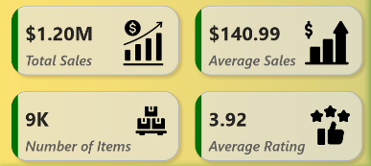
KPIs and Metrics:
KPIs Requirements:
Total Sales: The overall revenue generated from all items sold.
Average Sales: The average revenue per sale.
Number of Items: The total count of different items sold.
Average Rating: The average customer rating for items sold.

Slide 7
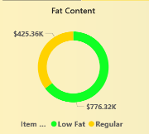
Visualizations:
Total Sales by Fat Content:
Objective: Analyze the impact of fat content on total sales.
Chart Type: Donut Chart.

Slide 8
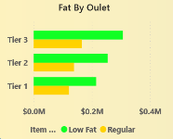
Visualizations:
Total Sales by Item Type:
Objective: Identify performance of different item types.
Chart Type: Bar Chart.

Slide 9
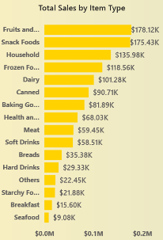
Visualizations:
Fat Content by Outlet for Total Sales:
Objective: Compare total sales across outlets segmented by fat content.
Chart Type: Stacked Column Chart.

Slide 10
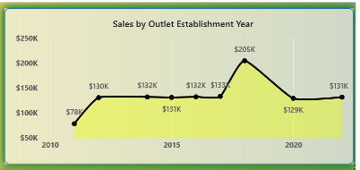
Visualizations:
Total Sales by Outlet Establishment:
Objective: Evaluate how outlet establishment year influences sales.
Chart Type: Line Chart.

Slide 11
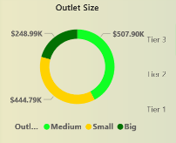
Visualizations:
Sales by Outlet Size:
Objective: Analyze correlation between outlet size and total sales.
Chart Type: Donut/Pie Chart.

Slide 12
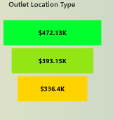
Visualizations:
Sales by Outlet Location:
Objective: Assess geographic distribution of sales.
Chart Type: Funnel Map.

Slide 13
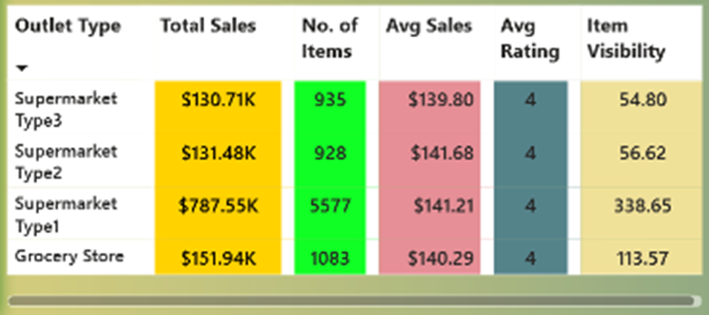
Visualizations:
All Metrics by Outlet Type:
Objective: Provide a comprehensive view of all key metrics.
Chart Type: Matrix Card.

Slide 14
Insights and Recommendations:
Key Findings:
Total Sales Performance:
Blinkit has achieved total sales of $1.20M.
The average sales per transaction are $140.99.
Product Performance:
The top-selling item types are Fruits and Vegetables ($178.12K) and Snack Foods ($175.43K).
Other significant contributors include Household items ($135.98K), Frozen Foods ($118.56K),
and Dairy products ($101.28K).
Customer Satisfaction:
The average customer rating is 3.92 out of 5.
Inventory and Sales Distribution:
Blinkit offers a total of 9K items.
Total sales by outlet size indicate that medium-sized outlets generate the highest sales ($507.90K), followed by large ($444.79K) and small outlets ($248.99K).
Sales are distributed across three tiers of outlet locations, with Tier 3 outlets generating the highest sales ($472.13K), followed by Tier 2 ($393.15K), and Tier 1 ($336.4K).
Outlet Establishment Year:
Sales have fluctuated over the years, with notable peaks around certain years (e.g., $205K in one year) and drops in others ($131K in 2020).
Fat Content Analysis:
Low-fat items have higher total sales ($776.32K) compared to regular fat items ($425.36K).
Outlet Type Analysis:
Supermarket Type 1 outlets have the highest total sales ($787.55K) and the highest number of items (5577), but their average sales ($141.21) and rating (4) are comparable to other types. Grocery stores have higher total sales ($151.94K) and item visibility (113.57), indicating effective inventory display.

Slide 15
Insights and Recommendations:
Recommendations
Sales Strategy Enhancement: Focus marketing efforts on top-performing product categories like Fruits and Vegetables and Snack Foods to further boost sales in these areas.
Explore opportunities to improve sales in lower-performing categories such as Seafood and Breakfast items by promotions or bundles.
Customer Satisfaction Improvement: Investigate areas contributing to the average rating of 3.92 and implement strategies to improve customer satisfaction, such as enhancing customer service and ensuring product quality.
Collect more detailed customer feedback to identify specific pain points and address them promptly.
Inventory Optimization: Continue to monitor and adjust inventory levels to ensure high-demand items are always in stock, especially in medium-sized outlets which have the highest sales.
Evaluate the performance of low-fat versus regular fat items and adjust inventory accordingly to align with consumer preferences.
Outlet Performance Analysis: Investigate the factors contributing to the high sales in medium-sized outlets and Tier 3 locations to replicate successful strategies in other outlet sizes and tiers.
Analyze the sales dips in certain years and identify external factors or internal issues that may have contributed to these fluctuations, implementing measures to avoid similar trends in the future.
Outlet Type Optimization: Leverage the high sales performance of Supermarket Type 1 outlets by potentially expanding their presence or adopting their successful practices in other outlet types.
Enhance the visibility and customer experience in other outlet types, particularly those with lower sales and item visibility, to boost their performance.
By implementing these recommendations, Blinkit can further optimize its sales performance, enhance customer satisfaction, and improve overall operational efficiency.

Slide 16
Overall Summary
Overall Summary for Blinkit Analysis The comprehensive analysis of Blinkit's sales performance, customer satisfaction, and inventory distribution reveals several key insights. Blinkit has achieved $1.20M in total sales with notable contributions from top-selling categories like Fruits and Vegetables and Snack Foods. The average customer rating stands at 3.92 out of 5, indicating room for improvement in customer satisfaction. Inventory analysis shows that medium-sized outlets generate the highest sales, with Tier 3 locations outperforming other tiers. Low-fat products are more popular, contributing to higher sales compared to regular fat items. Supermarket Type 1 outlets lead in total sales and inventory, suggesting effective strategies that could be replicated across other outlet types.
**Recommendations include** enhancing sales strategies for top and lower-performing product categories, improving customer satisfaction through targeted feedback and service improvements, optimizing inventory based on demand patterns, and leveraging successful outlet practices to boost overall performance.
Implementing these recommendations will help Blinkit optimize its sales performance, enhance customer satisfaction, and improve operational efficiency.

Slide 17
Thank You
Presented By
Rounak Pyne
rounakpyne.official@gmail.com

